Slide 1
Company Bankruptcy Prediction
BY
Varsha K
varshakrishna003@gmail.com

Slide 2
Problem Explanation
To predict whether a company is showing symptoms of getting bankrupt or not. The
problem statement is to develop a prediction model which will predict whether a
company can go bankrupt or not.
The dataset consists of multiple financial ratio columns such as:
Return on Assets (ROAs)
Gross Profits
Operating & Net income and Expenses
Cash flows
Taxes
Growth rate
Debt
Turnover, Revenue, Liability, etc.
Target column is Bankrupt with outcome as 0 or 1
(0 is No, 1 Yes)

Slide 3

2. Load data
Importing all the libraries like numpy, pandas, seaborn and more..
Loading the dataset using Pandas.
3. EDA
Checking the shape of the dataset and information using
shape
info()
Total 6819 rows and 95 columns
Checking if any duplicate values are presented – NO duplicate records

Slide 4
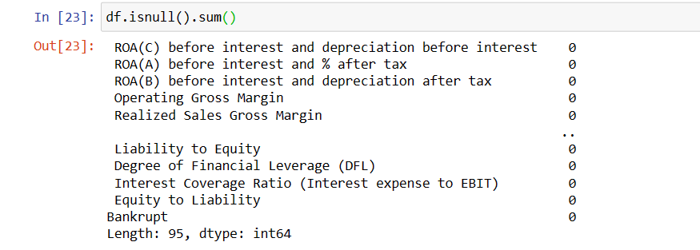
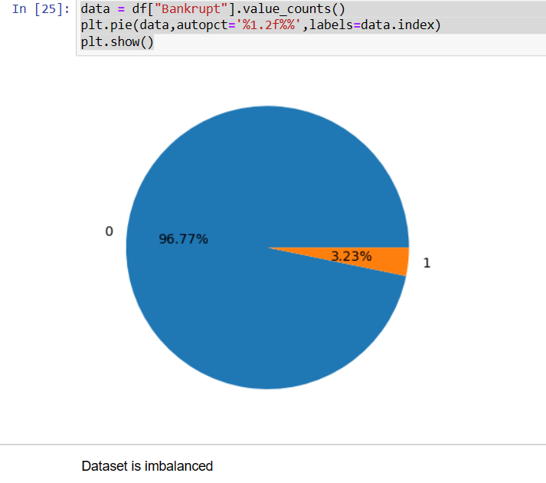
Checking NULL values or Missing values – NO null values
Checking for imbalance data
The labelled data of Bankruptcy is plotted and it is not balanced.
It is highly imbalanced dataset as only 3.2% of total data is of class label 1 (Bankrupt).
The pie chart describes the Bankruptcy where
0 is No
1 is YES

Slide 5
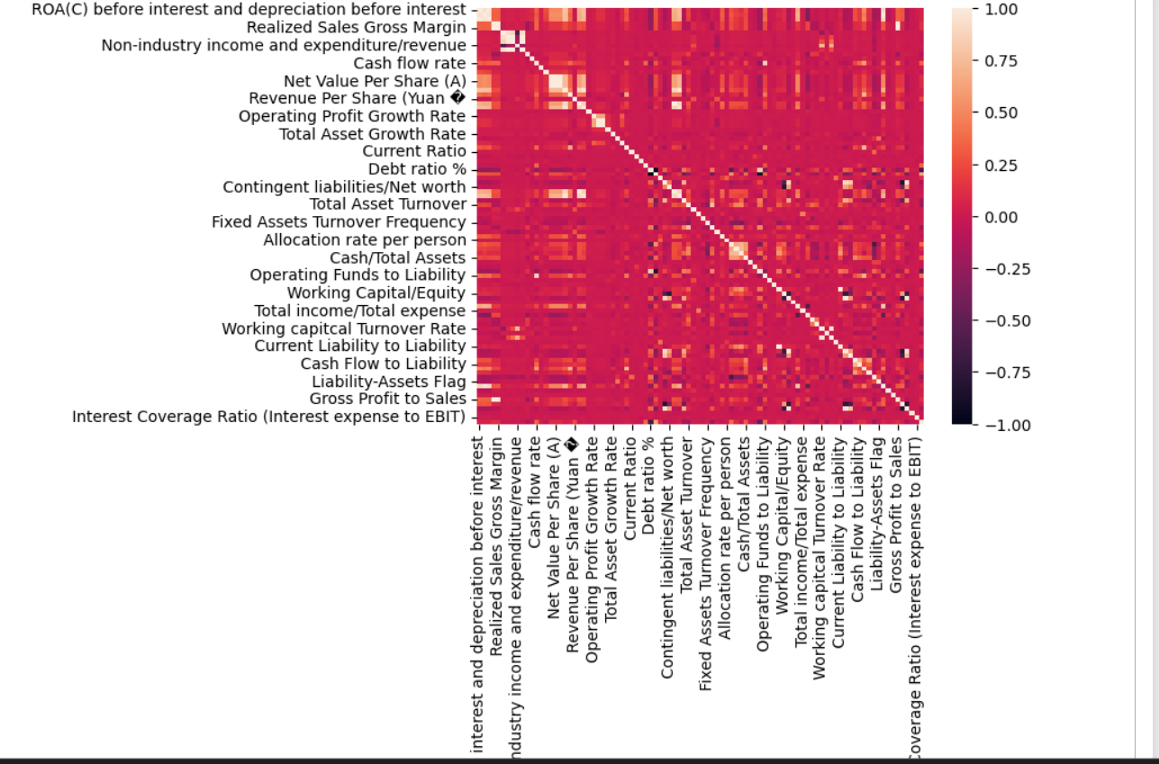
Multicollinearity
Checking the correlation between the variables using heatmap
Observations:
All three ROAs (ROA(a), ROA(b) and ROA(c) are positively correlated amongst each other.
Net value per share A,B and C are also highly correlated between each other.
Most of the variables are correlated

Slide 6
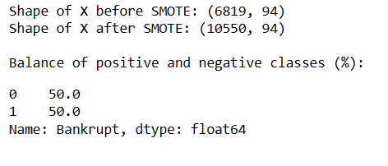
Split data to train data and test data
Training data set is used to train and develop models. Training sets are commonly
used to estimate different parameters or to compare different model performance.
The testing data set is used after the training is done. The training and test data are compared to check that the final model works correctly.
Balancing the data
As we see the data is imbalanced I am using SMOTE. SMOTE is a technique to oversample the minority class. Simply adding duplicate records of minority class often don’t add any new information to the model.

Slide 7
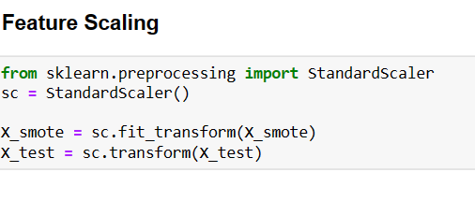
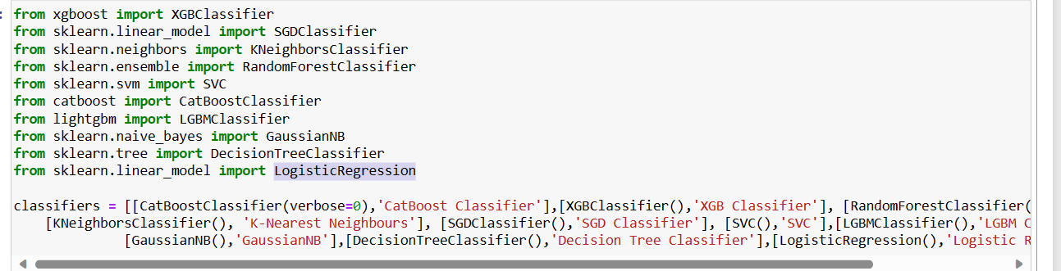
Feature Scaling
I could see the values having wide range, so I am using Standardization method to scale down the value.
MODELLING
I am importing all the classification model because the target value is classified as either 0 or 1 and using Logistic Regression model too and comparing the models with performance metrices.
The model which gives best Accuracy, Precision, recall, F1 score will be consider as best model for prediction.

Slide 8
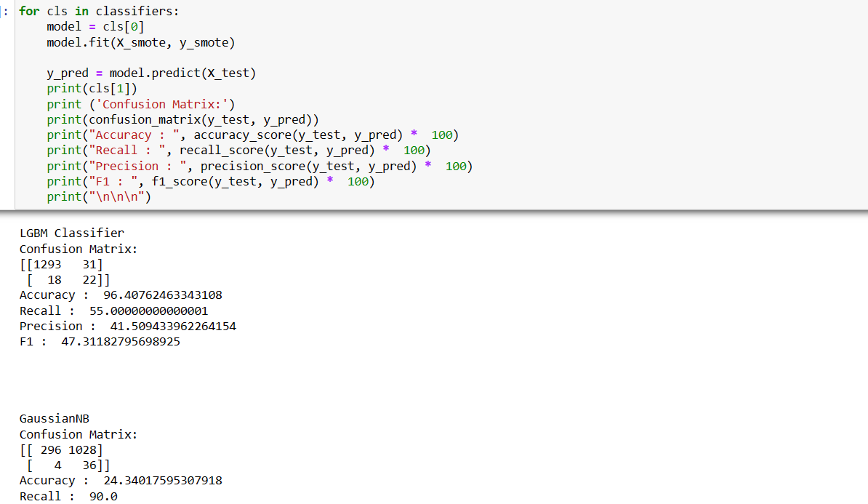
Performance Analysis
Compare performance of all models, metrics used:
accuracy
precision
recall
F1

Slide 9
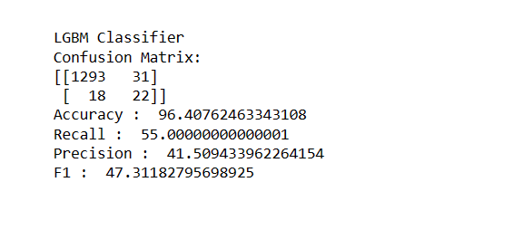
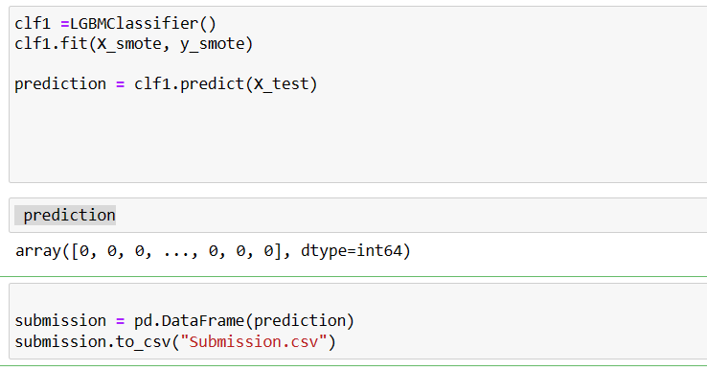
By comparing performance metrics, we can see that LGBM Classifier has the highest accuracy, precision, f1 scores and recall.
Building the model
LGBM Classifier is the best model with 96 % of accuracy . So using LGBM classifier model is built and take the prediction in Excel format .
Submission link
https://drive.google.com/file/d/1OkIm2FMa-7ZEHYbmyFdxVE4ZjFRRm0Qm/view?usp=share_link

Slide 10

Conclusion:
By comparing performance metrics, we can see that LGBM Classifier model has the highest accuracy, precision, f1 scores and recall rate becoming the best model for predicting bankruptcy. XGB Classifier perform secondly as well.
Using LGBM Classifier, model has been build and taken prediction for all the given dataset and submitted in excel format
https://drive.google.com/drive/folders/1FZZPeVw_wKf7eef10ZubaKyDXomwMBCj?usp=share_link

